Slide 1
NP-Completeness

Slide 2
NP-Completeness
Almost all the algorithms we have studied thus far have been polynomial-time algorithms: on inputs of size n, their worst-case running time is O(n^{k}) for some constant k.
There are problems, such as Turing’s famous “Halting Problem,” that cannot be solved by any computer, no matter how much time is provided.
There are also problems that can be solved, but not in time O(n^{k}) f or any constant k.
Generally, we think of problems that are solvable by polynomial-time algorithms as being tractable, or easy, and problems that require superpolynomial time as being intractable, or hard.

Slide 3
NP-Completeness
Here we will discuss, an interesting class of problems, called the “NP-complete” problems, whose status is unknown.
No polynomial-time algorithm has yet been discovered for an NP-complete problem, nor has anyone yet been able to prove that no polynomial-time algorithm can exist for any one of them.
This so-called P ≠ NP question has been one of the deepest, most perplexing open research problems in theoretical computer science since it was first posed in 1971.

Slide 4
NP-Completeness: Some Examples
Shortest vs. longest simple paths:
We know that even with negative edge weights, we can find shortest paths from a single source in a directed graph G = (V, E) in O(V E) time.
Finding a longest simple path between two vertices is NP-complete, however. In fact ,it is NP-complete even if all edge weights are 1.

Slide 5
NP-Completeness: Some Examples
Euler tour vs. Hamiltonian cycle:
An Euler tour of a connected, directed graph G = (V, E) is a cycle that traverses each edge of G exactly once, although it may visit a vertex more than once. We can determine whether a graph has an Euler tour in only O(E) time and, in fact, we can find the edges of the Euler tour in O(E) time.
A Hamiltonian cycle of a directed graph G = (V, E) is a simple cycle that contains each vertex in V. Determining whether a directed graph has a Hamiltonian cycle is NP-complete.

Slide 6
NP-Completeness: Some Examples
2-CNF satisfiability vs. 3-CNF satisfiability:
A boolean formula contains variables whose values are 0 or 1; boolean connectives such as ∧ (AND), ∨ (OR), and ￢ (NOT); and parentheses.
A boolean formula is satisfiable if there is some assignment of the values 0 and 1 to its variables that causes it to evaluate to 1.
A boolean formula is in k-conjunctive normal form, or k-CNF, if it is the AND of clauses of ORs of exactly k variables or their negations.

Slide 7
NP-Completeness: Some Examples
For example, the boolean formula (x1 ∨ ￢x2) ∧ (￢x1 ∨ x3) ∧ (￢x2 ∨ ￢x3) is in 2-CNF. (It has the satisfying assignment x1 = 1, x2 = 0, x3 = 1.)
There is a polynomial-time algorithm to determine whether a 2-CNF formula is satisfiable.
Determining whether a 3-CNF formula is satisfiable is NP-complete.

Slide 8
NP-completeness and the classes P and NP
The class P consists of those problems that are solvable in polynomial time.
The class NP consists of those problems that are “verifiable” in polynomial time. What we mean here is that if we were somehow given a “certificate” of a solution, then we could verify that the certificate is correct in time polynomial in the size of the input to the problem.
For example: Hamiltonian-cycle problem and 3-CNF satisfiability.

Slide 9
NP-completeness and the classes P and NP
Any problem in P is also in NP, since if a problem is in P then we can solve it in polynomial time without even being given a certificate.
Now we can believe that P ⊆ NP. The open question is whether or not P is a proper subset of NP.
a problem is in the class NPC(NP-complete) if it is in NP and is as “hard” as any problem in NP.
If any NP-complete problem can be solved in polynomial time, then every problem in NP has a polynomial-time algorithm.

Slide 10
Showing problems to be NP-complete
In showing a problem to be NP-complete, we are making a statement about how hard it is (or at least how hard we think it is), not about how easy it is.
In this way, NP-completeness proofs are somewhat like the proof of an (n lg n)-time lower bound for any comparison sort algorithm.

Slide 11
Three key concepts in showing a problem to be NP-complete:
1. Decision problems vs. optimization problems
NP-completeness applies directly not to optimization problems(shortest path), however, but to decision problems, in which the answer is simply “yes” or “no” (or, more formally, “1” or “0”).
There is a convenient relationship between optimization problems and decision problems.
We usually can cast a given optimization problem as a related decision problem by imposing a bound on the value to be optimized.
If we can provide evidence that a decision problem is hard, we also provide evidence that its related optimization problem is hard.

Slide 12
Three key concepts in showing a problem to be NP-complete:
2. Reductions
Let us consider a decision problem, say A, which we would like to solve in polynomial time.
Now suppose that there is a different decision problem, say B, that we already know how to solve in polynomial time.
Finally, suppose that we have a procedure that transforms any instance α of A into some instance β of B with the following characteristics:
1. The transformation takes polynomial time.
2. The answers are the same. That is, the answer for α is “yes” if and only if the answer for β is also “yes.”

Slide 13

Three key concepts in showing a problem to be NP-complete:
2. Reductions
We use polynomial-time reductions in the opposite way to show that a problem is NP-complete.
Suppose we have a decision problem A for which we already know that no polynomial-time algorithm can exist.
Suppose further that we have a polynomial-time reduction transforming instances of A to instances of B.
Now we can use a simple proof by contradiction to show that no polynomial time algorithm can exist for B.

Slide 14
Three key concepts in showing a problem to be NP-complete:
2. Reductions
Otherwise, suppose that B has a polynomial-time algorithm.
Then, using the method shown in above Figure, we would have a way to solve problem A in polynomial time, which contradicts our assumption that there is no polynomial-time algorithm for A.
The proof methodology is that, we prove that problem B is NP-complete on the assumption that problem A is also NP-complete.

Slide 15
Three key concepts in showing a problem to be NP-complete:
3. A first NP-complete problem
Because the technique of reduction relies on having a problem already known to be NP-complete in order to prove a different problem NP-complete.
We need a “first” NP-complete problem. The problem we shall use is the circuit-satisfiability problem, in which we are given a boolean combinational circuit composed of AND, OR, and NOT gates, and we wish to know whether there is any set of boolean inputs to this circuit that causes its output to be 1.

Slide 16
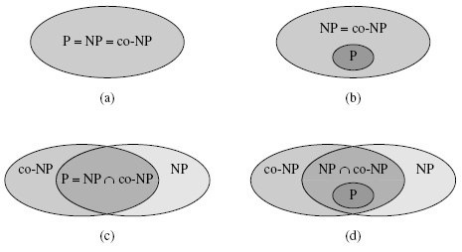
Four possibilities for relationships among complexity classes
(a) P = NP = co-NP. Most researchers regard this possibility as the most unlikely.
(b) If NP is closed under complement, then NP = co-NP, but it need not be the case that P = NP.
(c) P = NP∩co-NP, but NP is not closed under complement.
(d) NP ≠ co-NP and P ≠ NP∩co-NP. Most researchers regard this possibility as the most likely.

Slide 17
NP-completeness
This class has the surprising property that if any NP-complete problem can be solved in polynomial time, then every problem in NP has a polynomial-time solution, that is, P = NP.
Despite years of study, though, no polynomial-time algorithm has ever been discovered for any NP-complete problem.

Slide 18
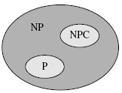
Relationships among P, NP, and NPC
How most theoretical computer scientists view the relationships among P, NP, and NPC. Both P and NPC are wholly contained within NP, and P ∩NPC = ∅.

Slide 19
Examples:
There are many important problems, however, for which no polynomial-time algorithm has been found, nor has the impossibility of such an algorithm been proved.
Here is just a small sample of some of the
best-known problems that fall into this category:

Slide 20
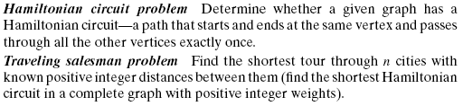
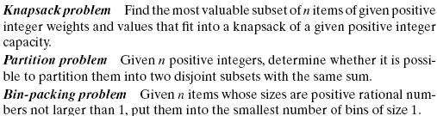
Examples:

Slide 21
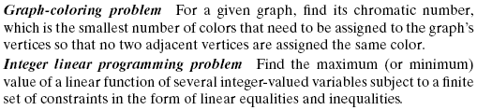
Examples:

Slide 22
NP-completeness
A language L ⊆ {0, 1}∗ is NP-complete if
1. L ∈ NP, and
2. L’ ≤P L for every L’ ∈ NP.
If a language L satisfies property 2, but not necessarily property 1, we say that L is NP-hard.

Slide 23
method for proving that a language L is NP-complete:
1. Prove L ∈ NP.
2. Select a known NP-complete language L’.
3. Describe an algorithm that computes a function f mapping every instance x ∈ {0, 1}∗ of L’ to an instance f (x) of L.
4. Prove that the function f satisfies x ∈ L’ if and only if f (x) ∈ L for all x ∈ {0, 1}∗.
5. Prove that the algorithm computing f runs in polynomial time.

Slide 24
SAT is NP-complete
We start by arguing that SAT ∈ NP.
Then we prove that SAT is NP-hard by showing that CIRCUIT-SAT ≤_{P} SAT
1. SAT ∈ NP: Given a satisfying assignment, the verifying algorithm replaces each variable with its value and evaluates the formula in polynomial time.

Slide 25
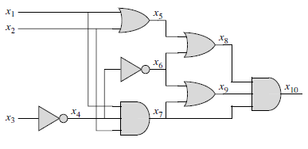
SAT is NP-complete…
2. Show that CIRCUIT-SAT ≤_{P} SAT.
φ = x₁₀ ∧ (x₁₀ ↔ (x₇ ∧ x₈ ∧ x₉))
∧ (x₉ ↔ (x₆ ∨ x₇))
∧ (x₈ ↔ (x₅ ∨ x₆))
∧ (x₇ ↔ (x₁ ∧ x₂ ∧ x₄))
∧ (x₆ ↔￢x₄)
∧ (x₅ ↔ (x₁ ∨ x₂))
∧ (x₄ ↔￢x₃).

Slide 26
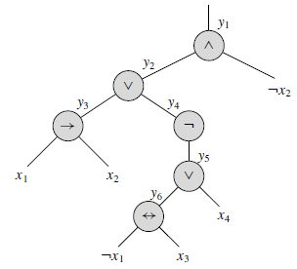
3-CNF is NP Complete
First, we construct a binary “parse” tree for the input formula φ, with literals as leaves and connectives as internal nodes.
parse tree for the formula
φ = ((x1 → x2)∨￢((￢x1 ↔ x3) ∨ x4))∧￢x2 .

Slide 27
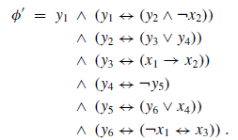
3-CNF is NP Complete…

Slide 28
3-CNF is NP Complete…
The second step of the reduction converts each clause φ_{i}’ into conjunctive normal form. For that we construct a truth table for φ_{i}’ by evaluating all possible assignments to its variables.
Using the truth-table entries that evaluate to 0, we build a formula in disjunctive normal form (or DNF)—an OR of AND’s—that is equivalent to ￢φ_{i}’.
We then convert this formula into a CNF formula φ_{i}’’ by using DeMorgan’s laws.

Slide 29
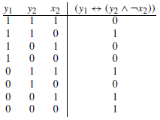
3-CNF is NP Complete…
we convert the clause φ₁’= (y1 ↔ (y2 ∧ ￢x2)) into CNF as follows.
The DNF formula equivalent to ￢φ₁’ is
(y1 ∧ y2 ∧ x2) ∨ (y1 ∧￢y2 ∧ x2) ∨ (y1 ∧￢y2 ∧￢x2) ∨ (￢y1 ∧ y2 ∧￢x2)
After applying DeMorgan’s Law, we get the equivalent CNF formula
Φ₁”= (￢y1 ∨￢y2 ∨￢x2) ∧ (￢y1 ∨ y2 ∨￢x2)
∧ (￢y1 ∨ y2 ∨ x2) ∧ (y1 ∨￢y2 ∨ x2)

Slide 30
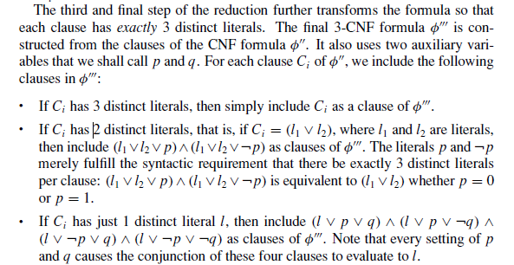
3-CNF is NP Complete…

Slide 31
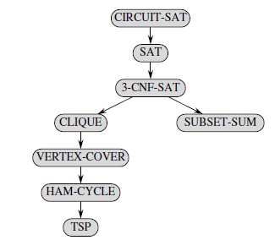
The structure of NP-completeness proofs

